Slide 1

Forecasting Energy Consumption in Chicago: A Comprehensive Analysis for Sustainable Urban Development
Group 3: Anvesh Reddy Pasula Rashmini Akkapally Jyothsna Abboju Shankar Chandra Rahul Bojja

Slide 2


Introduction
Unraveling the intricate dynamics of energy consumption in Chicago.
A data-driven journey focusing on predictive modeling for energy usage.
Exploration of residential structures, with a specific emphasis on single-family homes.
Decoding patterns and relationships among key features.
Contribute actionable insights for sustainable and informed decision-making in urban energy planning.

Slide 3

Problem Statement
In urban residential communities, optimizing energy consumption for sustainability is crucial. Diverse building types contribute to varying energy usage patterns, making it essential to identify drivers for efficient resource allocation and environmental conservation in single-family residences. This project aims to address these challenges, fostering sustainability and informing targeted urban planning for a greener, more efficient future.

Slide 4




Use Cases :
Sustainability Initiatives
Utility Management
Urban Planning
Policy Formulation

Slide 5
Goals
Identify influential Features Affecting Total Energy Consumption.
Develop a Comprehensive Predictive Model for Total Energy Usage.
Evaluate Model Accuracy and Robustness for Total Energy Prediction.

Slide 6

Dataset overview
The dataset encompasses a range of metrics including total electricity and gas usage, housing unit occupancy, demographics, building characteristics, and more for the year 2010 in Chicago.
The dataset comprises 67,051 rows and encompasses 73 features.
Data Source: https://data.cityofchicago.org/Environment-Sustainable-Development/Energy-Usage-2010/8yq3-m6wp/data
Total size of the dataset: 24.7MB

Slide 7
Key Features
Target Variable: ‘Total Energy’ - a combination of total kWh and total therms.
Feature Variables: 'TOTAL POPULATION,' 'OCCUPIED UNITS,' 'RENTER-OCCUPIED HOUSING PERCENTAGE,' 'ZERO KWH ACCOUNTS,' 'TOTAL UNITS,' 'AVERAGE STORIES,' 'OCCUPIED UNITS PERCENTAGE,' 'OCCUPIED HOUSING UNITS,' 'TOTAL ACCOUNTS,' 'TOTAL SQFT.'

Slide 8
Column Descriptions
TOTAL KWH: Total kilowatt-hours of electricity consumed.
TOTAL THERMS: Total amount of natural gas consumed in therms.
ELECTRICITY ACCOUNTS: Number of accounts using electricity.
GAS ACCOUNTS: Number of accounts using gas.
TOTAL POPULATION: Total population in the area.
OCCUPIED UNITS: Total number of occupied housing units.
RENTER-OCCUPIED HOUSING UNITS: Number of housing units that are renter-occupied.
RENTER-OCCUPIED HOUSING PERCENTAGE: Percentage of housing units that are renter-occupied.
ZERO KWH ACCOUNTS: Number of accounts with zero kilowatt-hours used.
KWH TOTAL SQFT: Total SQFT associated with Electricity Usage
THERMS TOTAL SQFT: Total SQFT associated with Gas Usage.
TOTAL UNITS: Total number of housing units.
AVERAGE STORIES: Average number of stories in buildings.
AVERAGE BUILDING AGE: Average age of buildings.
AVERAGE HOUSESIZE: Average size of houses.
OCCUPIED UNITS PERCENTAGE: Percentage of housing units that are occupied.
OCCUPIED HOUSING UNITS: Number of housing units that are occupied.

Slide 9
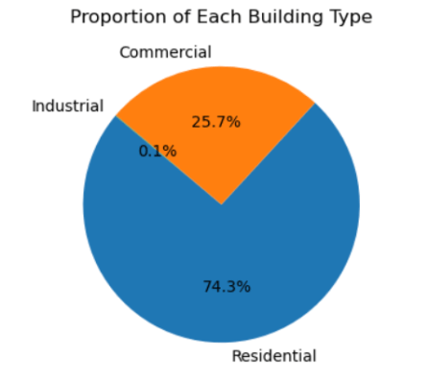
Data Analysis and Cleaning
There are three building types available in our data set - Residential, Commercial, Industrial.
Out of the total 67,051 records, 49,747 are residential, 17,185 are commercial, and the remaining 47 records belong to industrial properties.

Slide 10
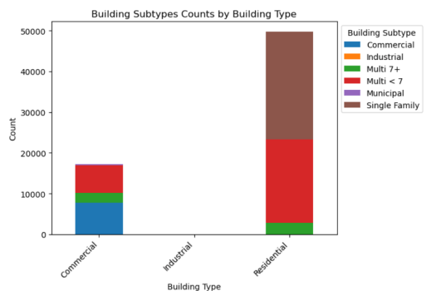
Data Analysis and Cleaning Cont.
The dataset includes various building types, each categorized with specific subtypes to provide detailed insights into the diverse structures present in the city.
Commercial:
Commercial 7775
Multi < 7 6731
Multi 7+ 2396
Municipal 282
Single Family 1
Industrial:
Industrial 42
Residential:
Single Family 26365
Multi < 7 20553
Multi 7+ 2829

Slide 11
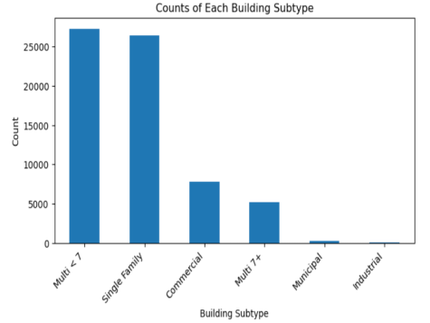
Data Analysis and Cleaning Cont.
There are six building sub types in the data set those are categorized into Multi < 7, Multi 7+, Commercial, Single Family, Municipal, Industrial.
Below are the number of records present in each building sub type:
Multi < 7 27284
Single Family 26366
Commercial 7775
Multi 7+ 5225
Municipal 282
Industrial 42

Slide 12

Data Analysis and Cleaning Cont.
Our project focus exclusively on residential single-family buildings, enhancing the precision of the analysis.
Industrial and commercial building types are systematically removed from the dataset, streamlining the focus towards residential structures.
Subtypes such as 'Multi < 7' and 'Multi 7+' are excluded, narrowing down the dataset to single-family residential structures.
The overall filtering strategy is geared towards optimizing the dataset for urban planning and energy consumption modeling efforts, aligning with the project goals.

Slide 13
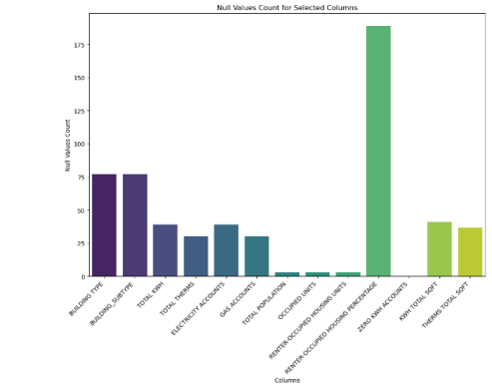
Data Analysis and Cleaning Cont.
Null Value treatment :
Null values in critical columns, including 'BUILDING TYPE', 'BUILDING_SUBTYPE', 'TOTAL KWH', 'TOTAL THERMS', 'ELECTRICITY ACCOUNTS', 'GAS ACCOUNTS', 'TOTAL POPULATION', 'OCCUPIED UNITS', 'RENTER-OCCUPIED HOUSING UNITS', 'RENTER-OCCUPIED HOUSING PERCENTAGE', 'ZERO KWH ACCOUNTS', 'KWH TOTAL SQFT', and 'THERMS TOTAL SQFT', have been removed.

Slide 14
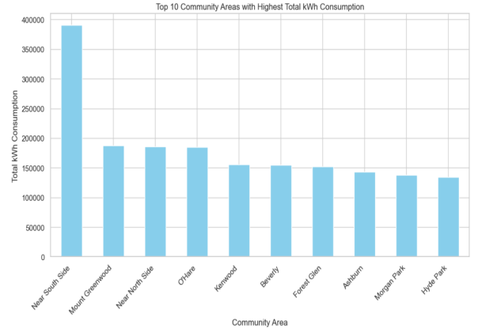
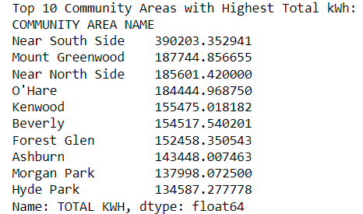
Exploratory Data Analysis
Top 10 Community Areas with Highest Total kWh:

Slide 15
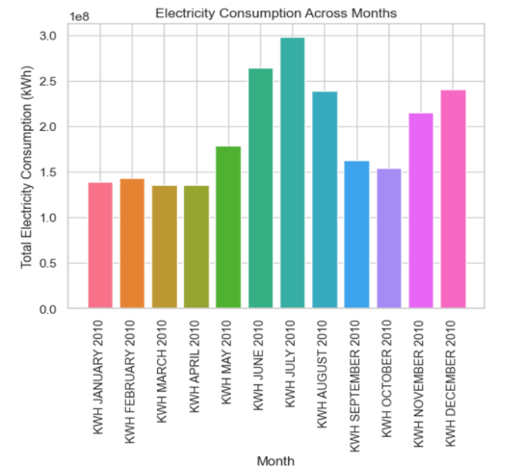
Exploratory Data Analysis Cont.
Seasonal Variation in Electricity Consumption: Total kWh Across Months.
Seasonal energy peaks in July and June result from heightened air conditioning use in summer, while increased demand in December and November is driven by heating needs, festive lighting, and higher building occupancy during holidays.

Slide 16
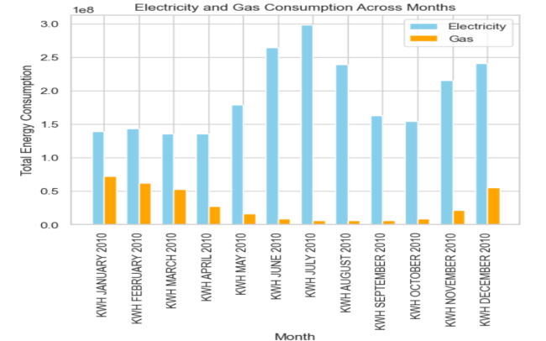
Exploratory Data Analysis Cont.
Total Energy - Electricity and Gas Consumption Across Months

Slide 17
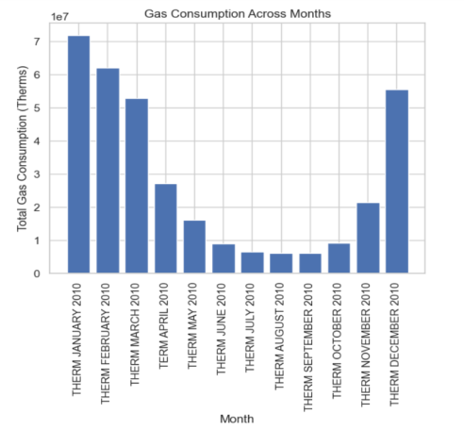
Exploratory Data Analysis Cont.
Seasonal Variation in Gas Consumption: Total Therms Across Months
Gas consumption surges during winter, particularly in December, as cold temperatures drive increased demand for gas heating systems, including furnaces, boilers, and water heaters.

Slide 18
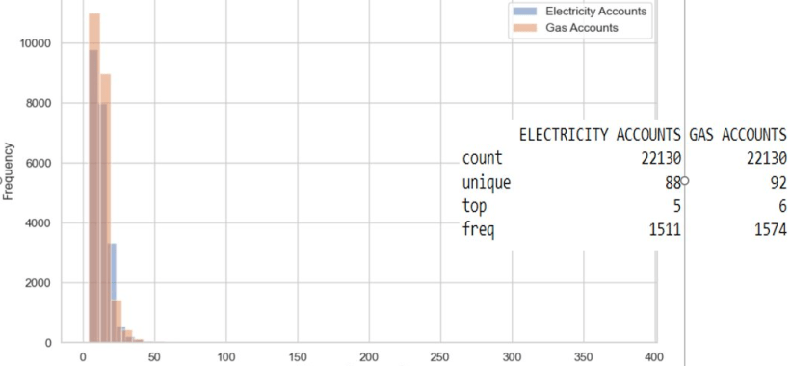
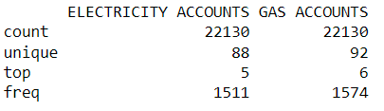
Exploratory Data Analysis Cont.
Data Distribution of 'ELECTRICITY ACCOUNTS' and 'GAS ACCOUNTS'
Gas and Electricity accounts Data Distribution

Slide 19
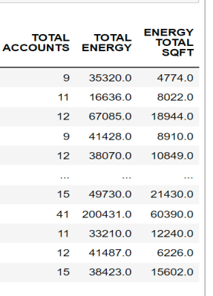
Data Preprocessing to transform raw data into a format suitable for machine learning models.
The new column ‘Total accounts’ is generated by summing the electricity accounts and gas accounts.
The ‘Total Energy’ column is created by summing the total electricity ( Total KWH) and gas consumption (Total THERMS).
The ‘Energy Total SQFT’ column results from summing the KWH TOTAL SQFT and THERMS TOTAL SQFT .

Slide 20
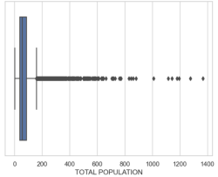
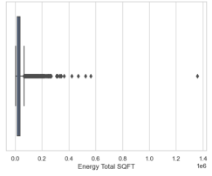
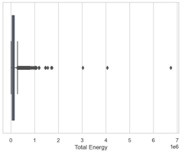
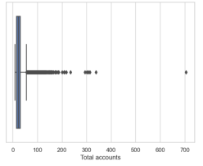
Removing Outliers We addressed outliers in the new dataframe containing target and feature variables by removal followed by imputing null values with the mean.
Subsequently, we visualized the impact through box plots before and after outlier handling.
Before :
Before removing outliers

Slide 21
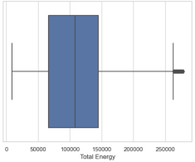
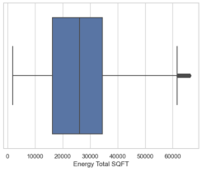
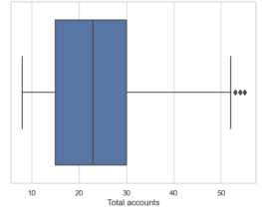
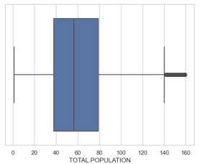
Removing Outliers
After :
After removing outliers

Slide 22
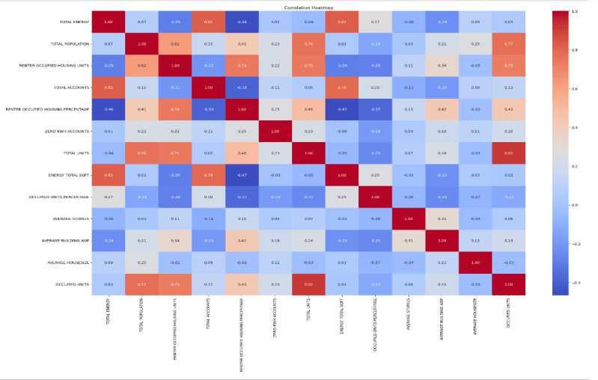
Correlation Matrix

Slide 23
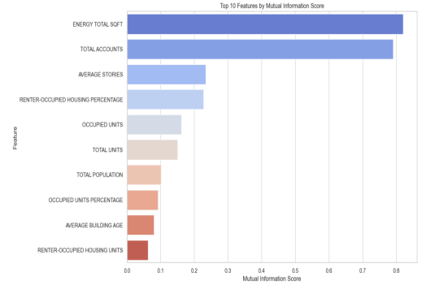
Data Standardization and feature selection
We employed Standardization to bring all data features to a common scale, ensuring a fair and unbiased comparison of their impacts in our analysis.
And we used the SelectKBest object to systematically identify and isolate the top 10 features from our dataset.

Slide 24

Machine Learning Regression Models
We split the dataset into training and testing sets, allocating 80% of the data for training and 20% for testing.
To predict the Total Energy based on selected feature variables, below ML regression models are used.
Linear Regression
Polynomial Regression
Decision Tree Regressor
Bagging Regressor
Random Forest Regressor
Gradient Boosting
XGB Regressor

Slide 25
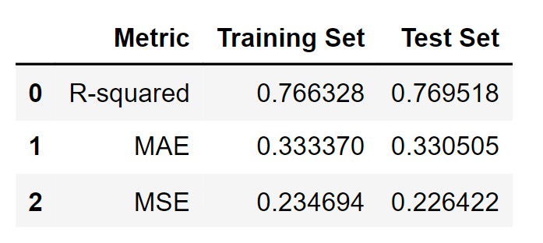
Linear Regression
Since our Target variable and Dependent variables are continuous, and we aim to predict a continuous outcome - we chose Linear regression model.
Below are the train and test prediction results.

Slide 26
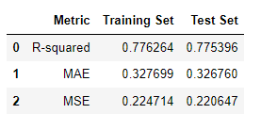
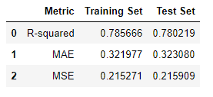
Polynomial Regression
We opted for polynomial regression (degree=2) following linear regression to account for potential non-linear patterns in the data.
The polynomial regression model achieved better performance than Linear Regression, as reflected in higher R-squared values and lower MAE and MSE.
We Performed a grid search using cross-validation to find the best parameters
Polynomial Regression
Best Parameters: {'polynomialfeatures__degree': 3}
The results from the grid search show higher R-squared values and lower error metrics (MAE and MSE) for both the training and test sets compared to the manually chosen degree of 2.
Polynomial Regression After tuning

Slide 27
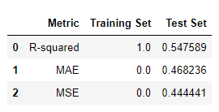
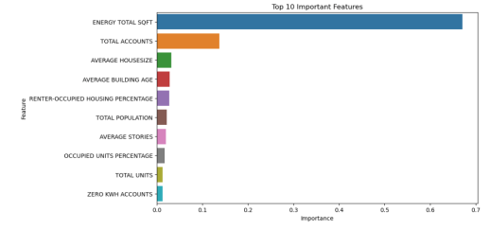
Decision Tree Regression
We aimed to enhance predictive accuracy and robustness using ensemble tree models, known for their efficacy in handling complex patterns
Utilizing the Decision Tree Regressor's feature_importances_, we re-analyzed our feature importance for tree-based models, aligning predictions more closely with their inherent structures.
The process revealed a challenge of high variance, signaling potential overfitting and reduced generalization capability.

Slide 28
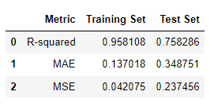
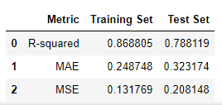
Bagging Regression
Bagging Regressor
Coming up with a challenge of High Variance and Overfitting, we decided to go with Bagged Regression
The results still doesn’t solve the issue of High Variance but sure did increase the accuracy.
We have conducted hyper-parameter tuning to fine-tune the model, the model was successful in mitigating High Variance, increasing robustness of model
Bagging Regressor after parameter tuning
Best Parameters: {'base_estimator'base_estimator__max_depth': None, 'base_estimator__min_samples_leaf': 4, 'base_estimator__min_samples_split': 2, 'max_features': 1.0, 'max_samples': 0.5, 'n_estimators': 100}

Slide 29
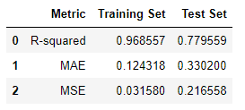
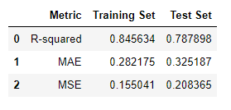
Random Forest Regression
Random Forest Regressor
In the process of increasing the R2 score and Robustness of the model, we have chosen Random Forest which has similar approach to the Bagged Regressor.
Random Forest also faced a challenge of High variance,but were able to reduce after tuning the hyper parameter.
Random Forest Regressor after parameter tuning
Best Parameters: {'max_depth': 10, 'min_samples_leaf': 4, 'min_samples_split': 10, 'n_estimators': 150}

Slide 30
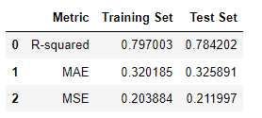
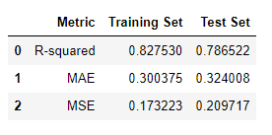
Gradient Boosting Regressor
Gradient Boosting
We have chosen Gradient boosting because of its strong predictive performance, and also provide good balance between test and train dataset.
We didn’t see much improvement in the results before and after tuning the hyper parameters,but were able to achieve better balance between test and train dataset.
Gradient Boosting after tuning
Best Parameters: {'learning_rate': 0.1, 'max_depth': 4, 'min_samples_leaf': 1, 'min_samples_split': 10, 'n_estimators': 200}

Slide 31
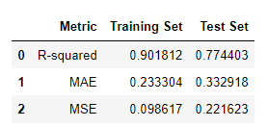
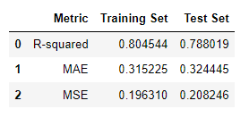
XGB Regressor
XGB Regressor
XGBoost is chosen for its advanced gradient boosting technique, regularization capabilities, handling of missing data, efficiency, and flexibility.
Could be very sensitive in the case of noisy data (Overfitting), but we don’t have noisy data in our dataset
Compared to Gradient Boosting, the balance between test and train is not maintained.
After tuning the parameters we were able to see the balance between Test and Train, resulting in Good Generalizations and Consistent performance.
XGB Regressor after tuning
Best Parameters: { 'gamma': 0.1, 'learning_rate': 0.1, 'max_depth': 3, 'min_child_weight': 3, 'n_estimators': 200, 'subsample': 1.0}

Slide 32
Hyper Parameter Tuning
In our project Hyper Parmeter Tuning, played an important role in solving the problem of High Variance, Overfitting and also maintaining Consistent accuracy for both Test and Train Datasets.
We used GridSearchCV for hyperparameters tuning.
In each and every case, it produced better results than the original model.
After tuning the parameters we were able to see the balance between Test and Train, resulting in Good Generalizations and Consistent performance.
Models after tuning | Train R2 Score | Test R2 Score
Polynomial Regressor | 0.785666 | 0.780219
Bagged Regressor | 0.868805 | 0.788119
Random Forest Regressor | 0.845634 | 0.787898
Gradient Boosting | 0.82753 | 0.786522
XG Boosting | 0.804544 | 0.788019

Slide 33
Model Evaluation & Conclusion
R-squared:
Bagged Regressor, and XG Boosting Regressor have similar and relatively higher R-squared values on the test set compared to other models.
MAE and MSE:
Bagged Regressor has the lowest MAE and MSE on the test set and train, suggesting smaller average prediction errors and squared errors.
Decision Factors:
Test Set Performance:
Bagged Regressor showed the best performance on the test set across multiple metrics.
Consistency:
XGBoost performs consistently well across R-squared, MAE, and MSE on the test set and train set.
Conclusion:
Considering the test and train set performance and the overall consistency, Bagged Regressor is the best-performing model among the ones evaluated. It provides a good balance between simplicity, interpretability, and predictive r2 score. And also comparatively lower MAE and MSE values.
Our findings provide actionable insights for sustainable urban planning and informed decision-making in residential energy consumption.
33

Slide 34
Advancements in Future
Prediction of Total Energy based on Geographical features:
Implementation of geographical features, such as latitude and longitude, in the predictive model to capture spatial variations in energy consumption. This enhancement aims to provide more accurate and localized predictions, accounting for regional influences on energy usage patterns.
Expansion to Industrial and Commercial Sectors:
In future phases of this project, to broaden the analysis to encompass the total energy consumption of Industrial and Commercial units. This extension will involve incorporating relevant features unique to these sectors, such as industrial processes, commercial square footage, and specific energy usage patterns. By including these components, we can provide a more comprehensive and nuanced understanding of energy consumption trends across diverse urban landscapes, enabling targeted strategies for energy efficiency and sustainability in both residential and commercial settings.

Slide 35
References
https://data.cityofchicago.org/Environment-Sustainable-Development/Energy-Usage-2010/8yq3-m6wp/data
Analysis of single- and multi-family residential electricity consumption in a large urban environment: Evidence from Chicago, IL - https://www.sciencedirect.com/science/article/abs/pii/S2210670722005558
Modelling using polynomial regression , Eva Ostertagová - https://www.sciencedirect.com/science/article/pii/S1877705812046085
Ensembles: Gradient boosting, random forests, bagging, voting, stacking - https://scikit-learn.org/stable/modules/ensemble.html

